Slide 1


Hedging Expressions in Contemporary British English: A Comprehensive Analysis
杨云雅 刘奕麟
2025.4

Slide 2
目录
01
02
03
Academic Background
Research Methods
Results

Slide 3
01
PART
Academic Background

Slide 4
Academic Background
Definition and Function of Hedging Expressions
01
Hedging expressions are linguistic devices used to modify propositions. They often serve to express politeness, vagueness, or mitigation in communication. In contemporary British English, "kind of" and "sort of" are two commonly used hedging expressions with similar meanings but different usage patterns.
Previous Research Findings
Previous studies have shown that "kind of" is more frequent in American English and in written contexts. In contrast, "sort of" is more common in British English and in spoken contexts. These findings highlight the contextual differences in the use of these hedging expressions.
02
03
Limitations of Previous Studies
Some studies focused on only one hedge rather than comparing the two, limiting the scope of their conclusions. Many studies used small corpora or databases, which affected the robustness and generalizability of their findings. Earlier works often analyzed the hedges at only one level of granularity and did not explore multiple levels of analysis. Quantitative analyses were often less advanced, with some studies not using normalized frequencies or by- item analyses.

Slide 5
Innovative Parts of This Study
01
02
03
04
Use of a Larger and Diverse Corpus
Multi-level Analysis
Distinctive Collexeme Analysis
Rigorous Statistical Methods
This study employs the British National Corpus World edition, a large and diverse corpus that provides a comprehensive snapshot of British English in the early 1990s. The corpus includes both spoken and written language, covering a wide range of styles and varieties, which allows for a more robust analysis.
The study conducts a multi- level analysis to explore variations across different registers and text types. This approach provides a more nuanced understanding of how "kind of" and "sort of" are used in various contexts, revealing patterns that were not evident in previous studies.
Distinctive collexeme analysis is applied to identify lexical co- occurrence preferences. This method helps to uncover the specific lexical items that frequently co- occur with "kind of" and "sort of," providing insights into their usage patterns.
The study addresses methodological shortcomings of previous studies by using more rigorous statistical methods and by- item analyses. The Fisher- Yates exact test is used to determine significant preferences, and the results are transformed into collostruction strength values to indicate the strength of preferences.

Slide 6
02
PART
Research Methods

Slide 7
Data Retrieval and Annotation
Corpus Selection
Annotation Parameters
Annotation Process
The study retrieved all instances of "kind of," "kinda," and "sort of" from the British National Corpus World edition. This corpus is a snapshot of British English in the early 1990s, comprising text samples generally no longer than 45,000 words.
Each instance was annotated for mode (spoken or written), medium (within writing), domain type (e.g., arts, imaginative, leisure), genre type, part of speech of the modified expression, and lemma of the modified expression. This detailed annotation allows for a comprehensive analysis of the usage patterns of "kind of" and "sort of" across various dimensions.
The annotation process involved identifying the specific linguistic features associated with each instance of the hedging expressions. This meticulous approach ensures that the data is accurate and reliable, providing a solid foundation for the subsequent statistical analysis.

Slide 8
Statistical Evaluation
01
02
03
Distinctive Collexeme Analysis
Fisher-Yates Exact Test
Collostruction Strength Values
The frequency distributions of the annotated parameters were evaluated using distinctive collexeme analysis with Coll.analysis 3, a program for R. This advanced statistical tool helps to identify significant lexical co- occurrence patterns, providing a deeper understanding of the usage preferences of "kind of" and "sort of."
The Fisher- Yates exact test was used to determine significant preferences in the usage of "kind of" and "sort of." This rigorous statistical method ensures that the findings are reliable and valid, supporting the conclusions drawn from the data.
The results of the statistical analysis were transformed into collostruction strength values to indicate the strength of preferences. These values provide a quantitative measure of the strength of lexical co- occurrence preferences, allowing for a more precise comparison of the usage patterns of the two hedging expressions.

Slide 9
03
PART
Results of the Study

Slide 10
Corpus Parts Analysis
Speaking vs. Writing
Media and Domains
Genre Preferences
"Sort of" is strongly preferred in spoken contexts, while "kind of" is preferred in written contexts. This pattern is consistent across various levels of granularity. The study confirms the contextual differences identified in previous research but provides a more robust analysis by examining a larger and more diverse corpus.
Within writing, "kind of" is preferred in periodicals, while "sort of" is preferred in books. Specific domains like arts and imaginative writing strongly prefer "kind of," while spoken domains generally prefer "sort of." These findings highlight the influence of register and text type on the choice between "kind of" and "sort of," revealing distinct preferences across different media and domains.
The study identifies specific genre preferences for "kind of" and "sort of," showing that these hedging expressions are used differently depending on the genre of the text. This multi- level analysis provides a more detailed understanding of the contextual factors that influence the usage of these expressions.

Slide 11
Collocates Analysis
Parts of Speech
01
"Kind of" prefers to modify nouns and adjectives, while "sort of" prefers to modify whole propositions, adverbs, and verbs. This finding indicates that the two hedging expressions have distinct lexical preferences, which influence their usage patterns in different contexts.
Lexical Preferences
Adjectives: "Kind of" modifies adjectives related to emotional states (e.g., "fun," "cool," "calm"), while "sort of" modifies color adjectives (e.g., "black," "dark," "grey"). Nouns: "Sort of" modifies quantified expressions and nouns referring to people (e.g., "people,","hair"). Verbs: "Kind of" modifies mental activity verbs (e.g., "know," "wish," "like"), while "sort of" modifies communication and perception verbs (e.g., "say," "look," "find").
02
03
Synonymy and Collocational Overlap
Despite being near synonyms, "kind of" and "sort of" exhibit relatively low collocational overlap with adjectives but higher overlap with nouns and verbs. This suggests that the two hedges are used in distinct contexts and with different lexical items, highlighting the importance of multi- level analysis in understanding their usage patterns.

Slide 12
Conclusions
Factors Governing Hedge Choice
The study demonstrates that the choice between "kind of" and "sort of" is governed by a combination of external factors (such as register and text type) and internal factors (such as lexical preferences). The findings highlight the complexity of hedge usage in contemporary British English and the importance of considering multiple factors in analyzing linguistic phenomena.
Importance of Multi-level Analysis
The study emphasizes the importance of multi- level analysis and rigorous statistical methods in corpus linguistics. By examining the usage patterns of "kind of" and "sort of" across different dimensions, the study provides a more comprehensive understanding of their usage in contemporary British English.
Future Research Directions
Future research could explore the multidimensional interactions between the factors identified in this study and investigate sociolinguistic determinants of hedge choice. This would further enhance our understanding of the usage patterns of hedging expressions and their role in communication.

Slide 13
Part4 方法详解、对比与应用
杨云雅

Slide 14

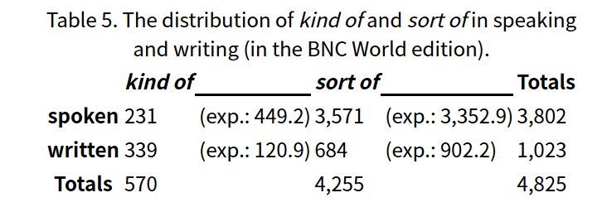
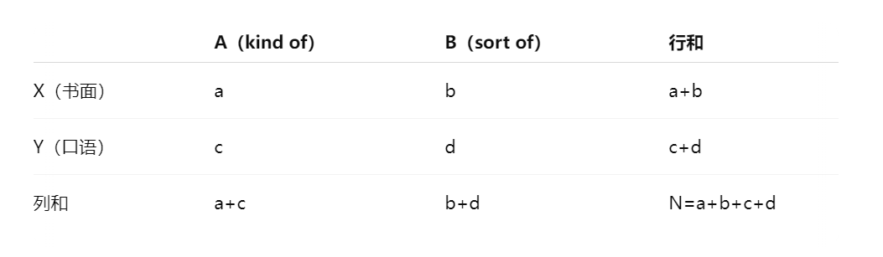
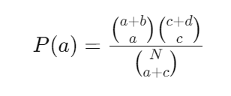
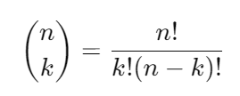
1.1 详解计算- fisher精确检验
# 边际总数固定，
a有多大可能像现在这么大？
02

Slide 15
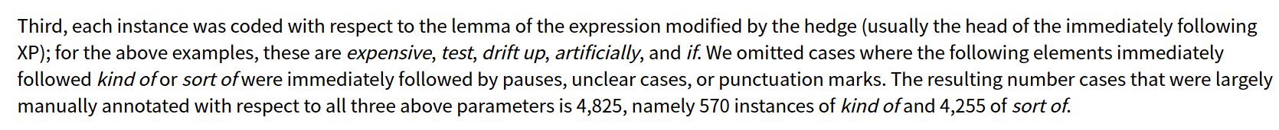

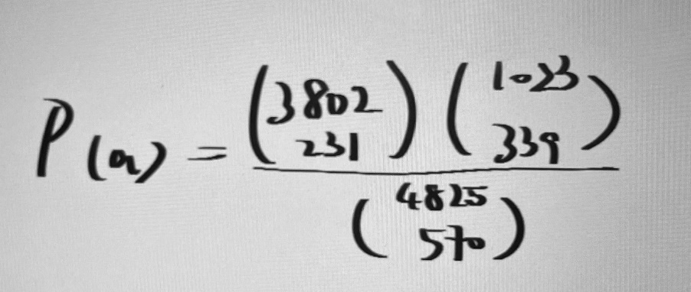
1.2 详解计算- CollStr
共现强度（collocational strength）
02
#这个关联显著吗
CollStr = -log10(p) ≈ 102
P=1.01e-102

Slide 16
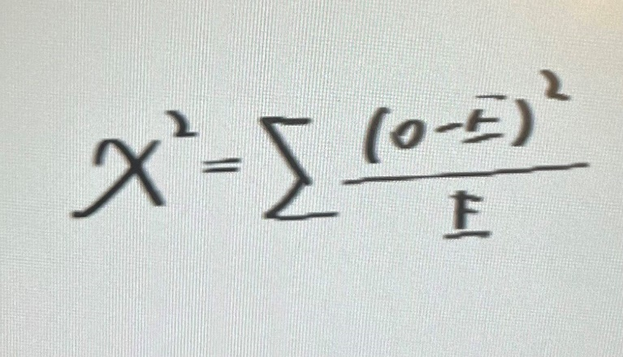
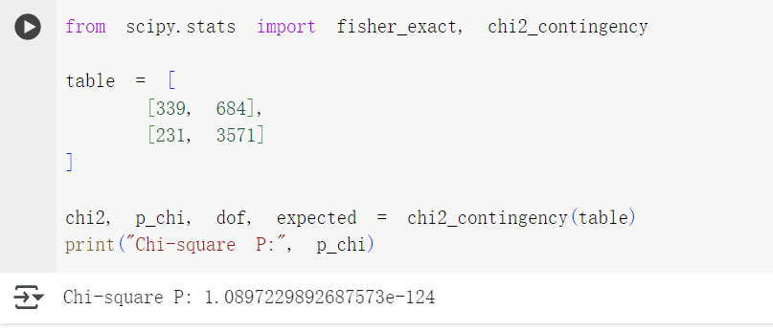
2. 与卡方检验（Chi2）对比
02
#比较实际值和预期值的差距

Slide 17
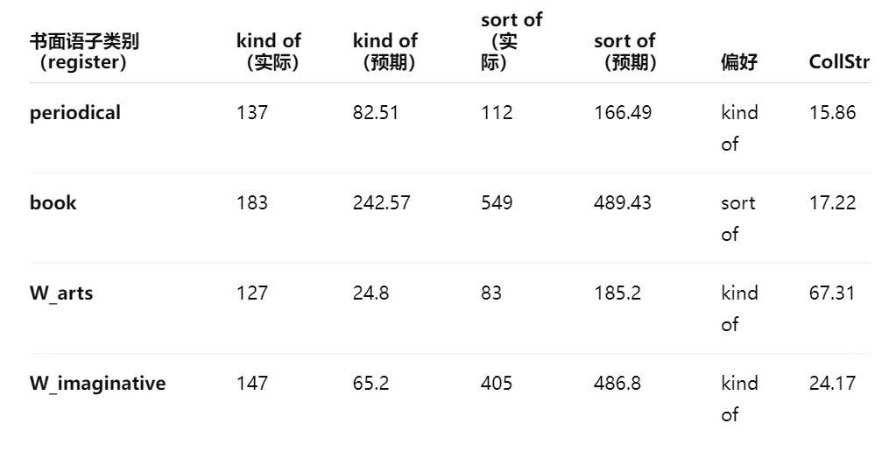
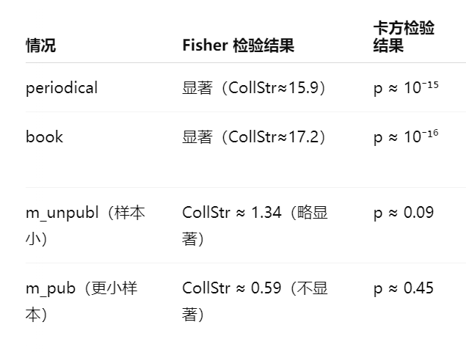
#fisher计算量较大，但在小样本中更精确

Slide 18
3. 应用：游戏数据- 美国梦
对比特朗普2017和2025总统就职演讲中dream一词的名词与动词用法分布
02

Slide 19
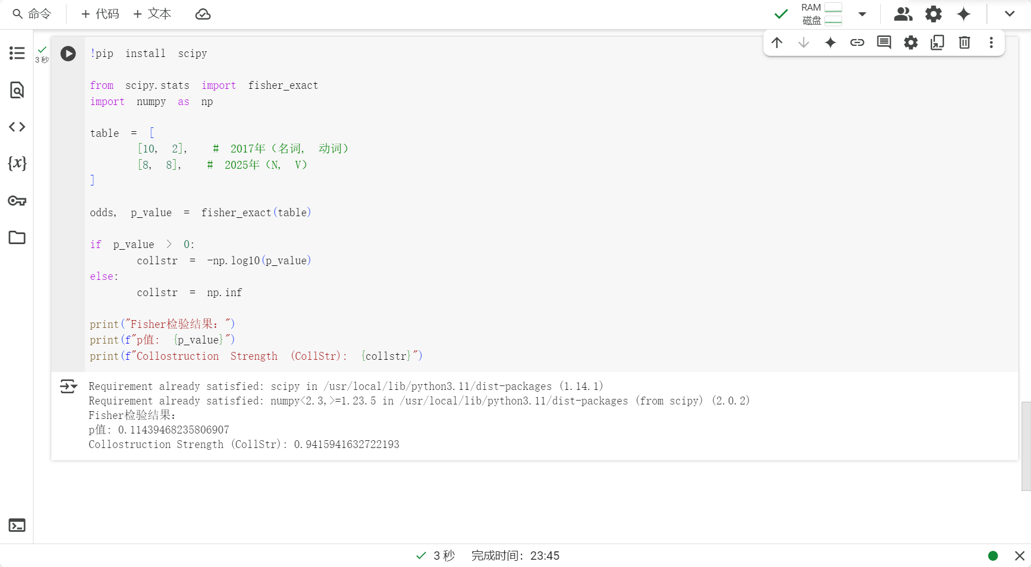
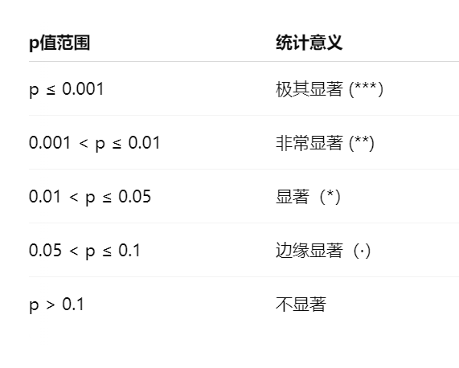

#在极小样本下稍稍显著hhh

Slide 20
THANKS

